Slide 1
Covid-19 Ethnicity Analysis - Southeast Region
Data Visualization Bootcamp Project 1
Group: Burnetta Wood, Keishauna Turner, Manar Soluiman, Spencer Fox, and Carline Philippe
April 17, 2021
Notes:
Angela's video - https://drive.google.com/open?id=1uASzIhN5ePMlXOQbwlVZMikkg3UKuSnh

Slide 2
Project Overview
Our project will focus on the Covid-19 pandemic data collected in the United States. We found this topic interesting as we wanted to see how the virus affected different ethnic groups in the selected states we chose for the research.

Slide 3
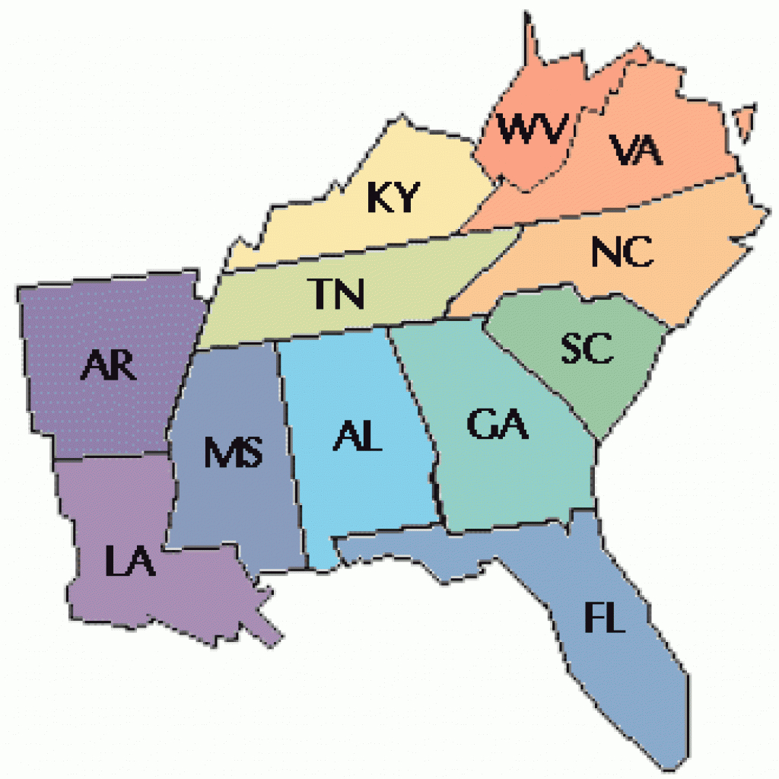
Project Motivation
Real-World Problem
We decided to focus on the states located in the Southeast Region of United States

Slide 4



Original Questions
Which ethnic group contains the most positive tests in each state?
What percentage of positive tests in each ethnic group resulted in death per state?
Which ethnic group had the most covid testing?

Slide 5
Data Clean Up
Extract Subset of Data
Review Other Datasets and make comparisons
Drop Empty Columns
Ignore Values Below Zero for Charts

Slide 6
Revised Questions
Which SE state had the most /least positive cases?
Who had the most/least deaths from testing positive?
Which SE State had the lowest/highest survival rate?
Which states had the highest recorded positive tests?
What is the total covid hospital count?
What percentage of the state’s covid cases is reported as hospital cases?

Slide 7
Data Analysis
Observations and Review
Review other datasets and make comparisons
Hypothesis
Black Population will have a higher death percentage
Dataset will adequately provide the data needed to answer questions
Enough insight is available to review all questions relating to the given dataset

Slide 8
Covid-19 Analysis For the Southeast Region

Slide 9
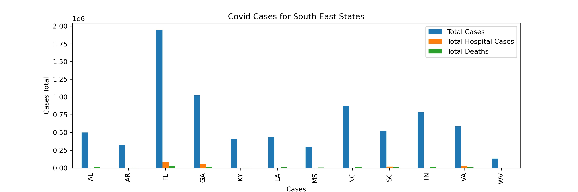
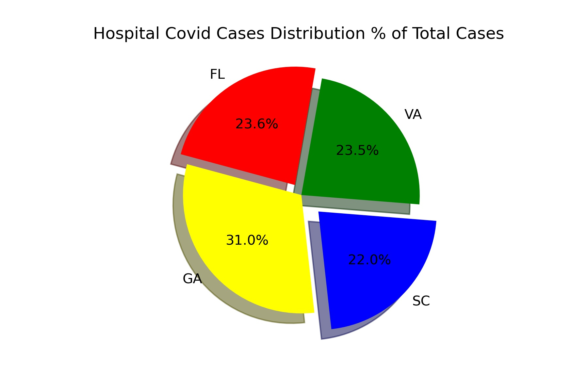
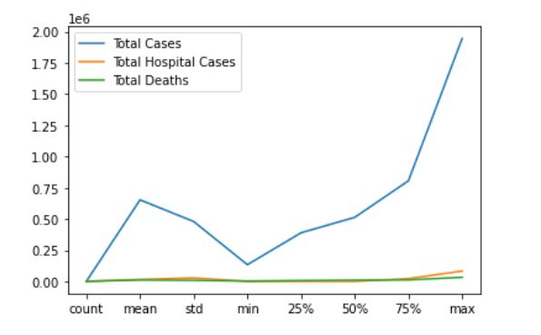

Slide 10
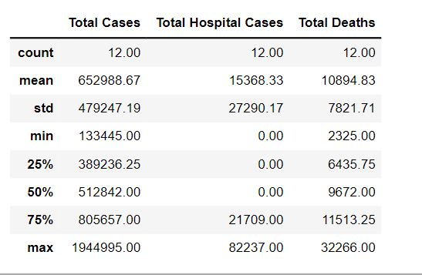
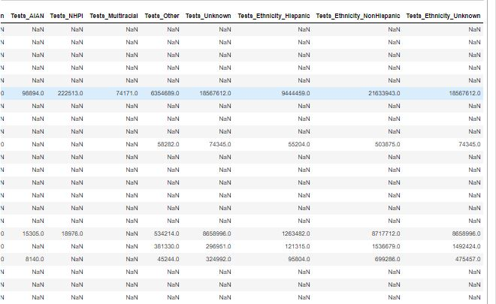
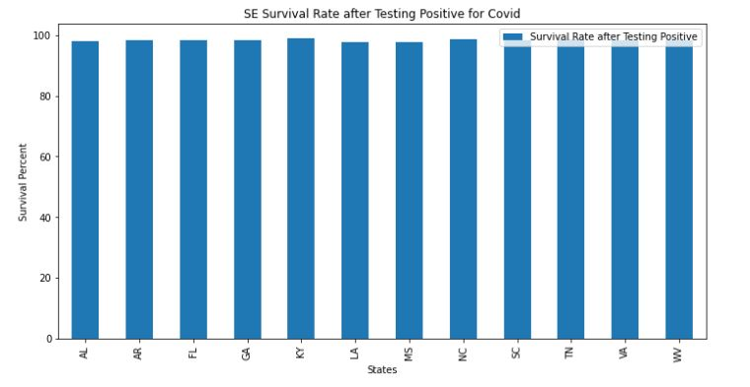

Slide 11
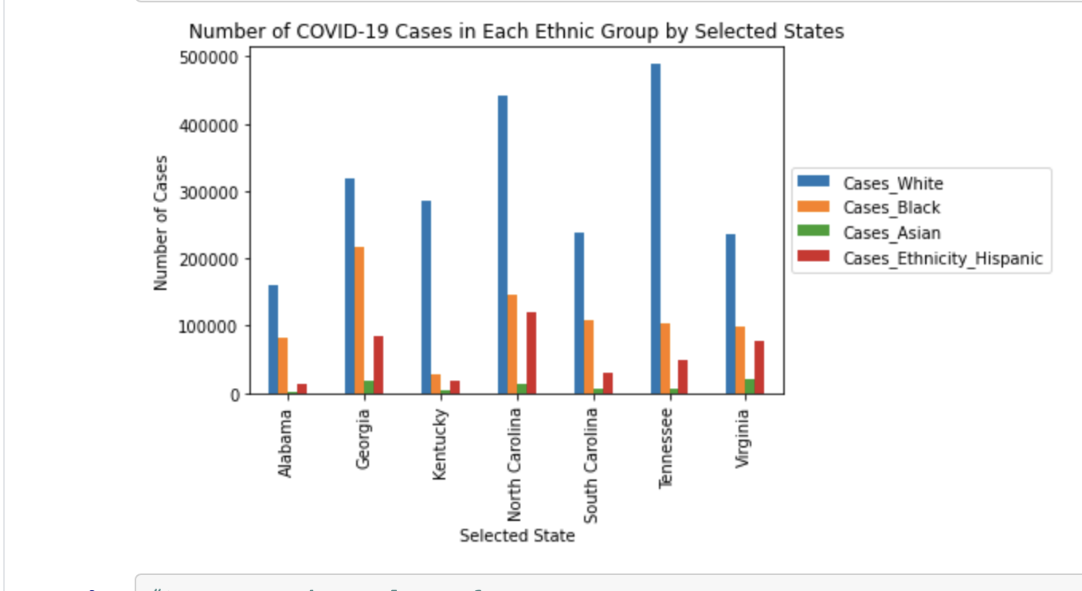
Number of Covid Cases

Slide 12
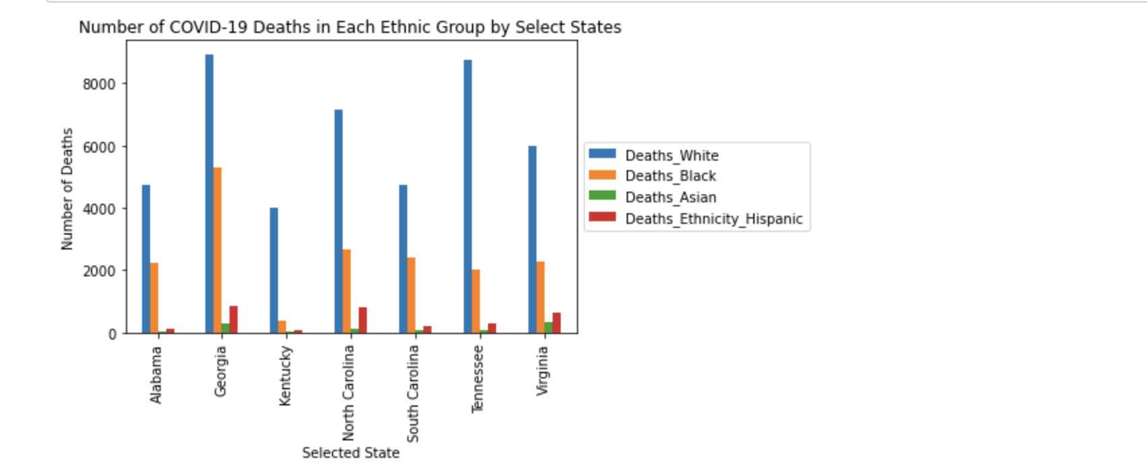
Number of Covid Deaths

Slide 13
Covid Deaths Bar Chart
Expected to see cases mirror roughly corresponding state population. Tennessee was the major exception. Further investigation indicated why Tennessee had a significant number of cases. In December of 2020, Tennessee was a world hotspot for COVID-19 virus transmission.
Many analysts point to Governor Bill Lee’s not requiring a mask mandate statewide but left decision up to each county to decide.

Slide 14
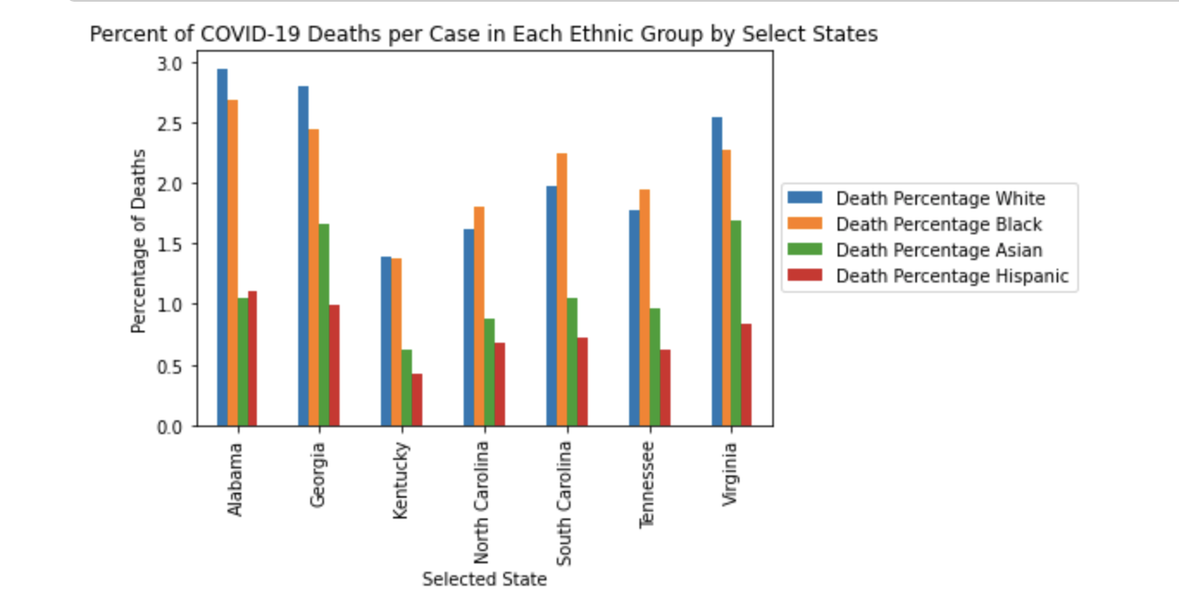
Percentage of Covid Deaths

Slide 15
Deaths Per COVID-19 Case
Assumptions
Percentage of Deaths Per Case to be roughly equal among states close to NC.
Black and Hispanic death percentages at a higher rate than White and Asian.
Results and Explanations
Alabama and Georgia death rates higher than other states possibly linked to overall healthcare ranking per those states.
Alabama and Georgia ranked 40 and 46 in overall healthcare by the Commonwealth Fund Scorecard on State Health System Performance. Virginia’s high percentage death rate may be explained by the state having the second highest nursing home death rate in the US.

Slide 16
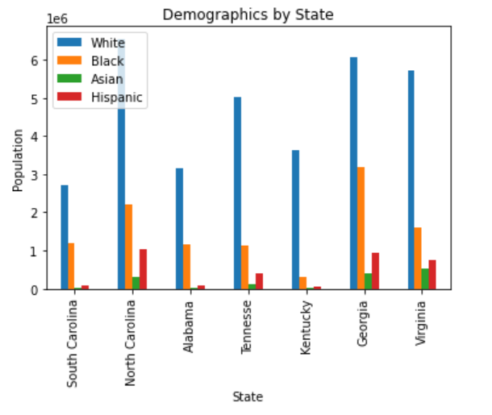
State Population by Race

Slide 17
Limitations & Racial Disparities
Limitations Of Racial Grouping
Testing Sites
Categorizing by ethnicity
Sub-ethnic groups
Latino/Hispanic
Asian/Middle Eastern
Racial Disparities
CDC’s Finding
Death Within Ethnic Groups by State’s Population
Example: North Carolina
White Population- 6,552,128 (7,160)
Black Population- 2,214,270 (2,662)

Slide 18
Conclusion
Majority of positive cases did not lead to death.
There were more white cases within all states analyzed.
1-2% of the Black population died within the analyzed states due to Covid.

Slide 19
Additional Limitations
Data did not provide enough data for a well-rounded assessment at conclusion
One of the biggest things we learned while moving through this project is the need for thoroughly analyzing the dataset to see if it contains the components necessary to answer the questions proposed.
The dataset, unfortunately did not have any testing data for most states by ethnic group….only certain states. We had to eliminate questions 1 & 3 because of this.

Slide 20
Quote
“We’ve compiled the race and ethnicity data that states are reporting for several COVID-19 data categories so that other researchers can begin to work with, analyze, and visualize this information. This is a challenging dataset to compile and code. While an increasing number of states and territories are providing race and ethnicity data, that data remains incomplete and inconsistent.”
About the Racial Data Tracker | The COVID Tracking Project
https://covidtracking.com/race

Slide 21
Data Resources Used
About the Racial Data Tracker | The COVID Tracking Project
https://covidtracking.com/race
CDC
https://covid.cdc.gov/covid-data-tracker/#datatracker-home

Slide 22

Q & A

